Slide 1
Stock Smart
Group Project

Slide 2
AGENDA
Vision
Team
Problem
Market
Business Model
Approach / Solution
Competition
Go-to-Market

Slide 3
VISION
Stock Smart is a one-stop stock explore tool that aggregates and presents historical price, stock rating, inside-trading activity, and headlining news for a given stock provided by user
For the premium users, Stock Smart also provides in-house stock prediction analysis

Slide 4

TEAM
Ananya Raghupathy
Data Analyst
Experience
https://www.linkedin.com/in/ananyaraghupathy/
Notes:
Add photo by 6pm today (10/30)

Slide 5

TEAM
Haoyu Wang
Data Analyst
https://www.linkedin.com/in/wanghaoyu/
Notes:
Add photo by 6pm today (10/30)

Slide 6
TEAM
Ruben Giro
Accounting Manager
https://www.linkedin.com/in/ruben-giro-4211605/
Leading accounting and finance organizations for Fortune 500 companies
Notes:
Add photo by 6pm today (10/30)

Slide 7

TEAM
Taiming Liu
Analyst Intern
https://www.linkedin.com/in/taimingliu
Notes:
Add photo by 6pm today (10/30)

Slide 8
PROBLEM (CUSTOMER PAIN)
Customer pain point
Difficult for retail investors to select stocks to invest in due to financial knowledge and the massive amount of information
Too many sources of information. Some require premium subscription fees
Current solution for this pain
Rely on stock brokers, financial advisers
Invest in Mutual funds
Notes:
Financial Advisor Fees source: https://www.nerdwallet.com/article/investing/how-much-does-a-financial-advisor-cost

Slide 9
PROBLEM (CUSTOMER PAIN)
Costly, unreliable, and outsourced decision making
Fee type | Typical cost
Assets under management (AUM) | 0.25% to 0.50% annually for a robo-advisor; 1% for a traditional in-person financial advisor.
Flat annual fee (retainer) | $2,000 to $7,500
Hourly fee | $200 to $400
Per-plan fee | $1,000 to $3,000
Notes:
Financial Advisor Fees source: https://www.nerdwallet.com/article/investing/how-much-does-a-financial-advisor-cost

Slide 10
MARKET
Target customer
Retail investors who want to learn and take control of their investment decisions
Analysts who need a fast & light-weight information gathering tool
Market size
One third of Americans own a broker account outside their retirement
Millennials and younger investors
Market forces / drivers
Many different offerings help investors make decision
Many investors are happy investing in the market, but others would like to receive advice on how to beat the average returns, and get better returns
Large number of offerings, but also very large number of customers

Slide 11
BUSINESS MODEL / UNIT ECONOMICS
Business Model
Premium users will be subject to a monthly/yearly subscription fee for additional services
Pricing details
$19 per month or $199 per year
We expect 70% of our customers to sign for the monthly plan and stay on average for 9 months. Customer contribution would be $20 * 9 month = $180. The 30% yearly customers would contribute $199 for a weighted blended rate of $186
We capture 1% market share of the 70 million households that own stock = 700,000 customers x $186 contribution rate per customer = $130 million revenue run-rate

Slide 12
Our Solutions
Provide investors with the information they need to make intelligent investment decisions
All relevant and important information in one place
Show how the different stock metrics may affect your returns
Continue to publish research and proven investing ideas

Slide 13
Historical Data
Stock Smart provides an insight into the historical data of any stock that the user enters.
Upon being prompted by the application, when a user enters the name of the stock he/she wants to look at the historical data of, StockSmart displays 29 parameters, a few of which are Revenue, Gross Margin Percentage, Operating Income, Net Income, Earnings per Share, Dividends, Payout Ratio, and so on for the entirety of the previous decade, starting from 2011 to 2020.
The user can make a well-informed decision if he/she needs to invest in that particular stock.

Slide 14
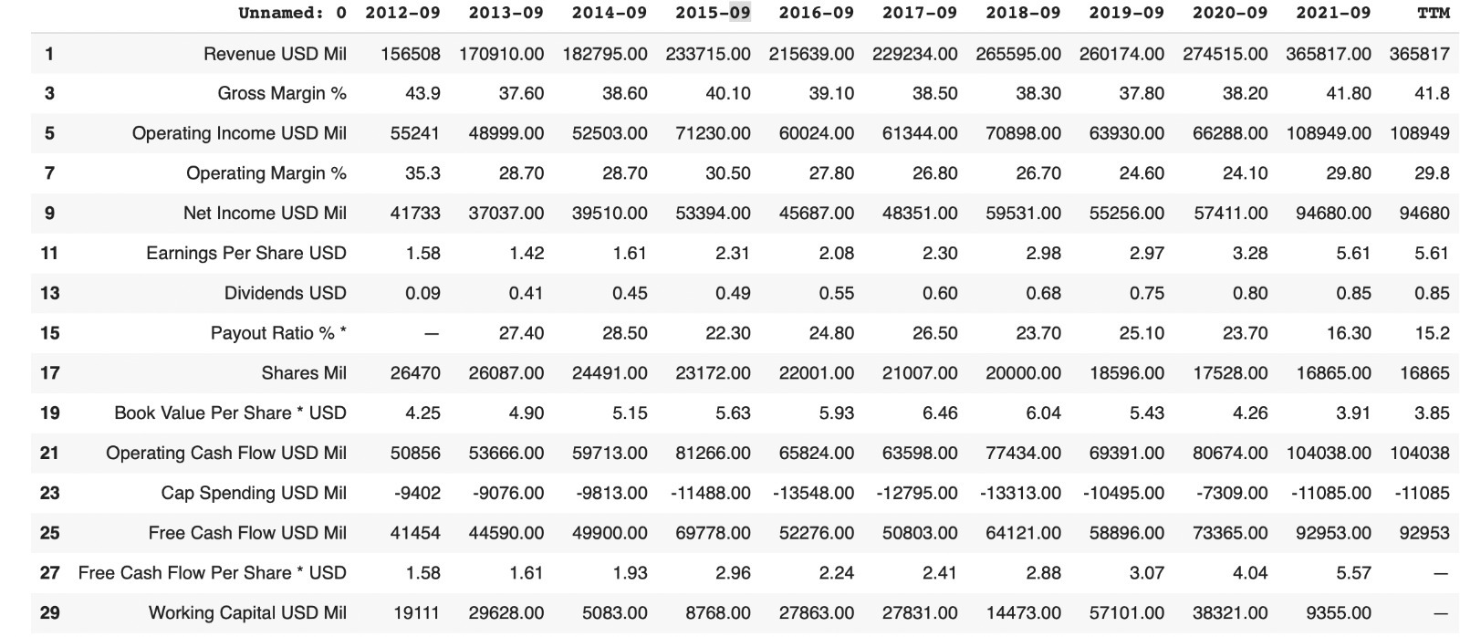
Historical Data
For example, let us look at the application when a user enters Apple’s stock APPL when prompted.

Slide 15
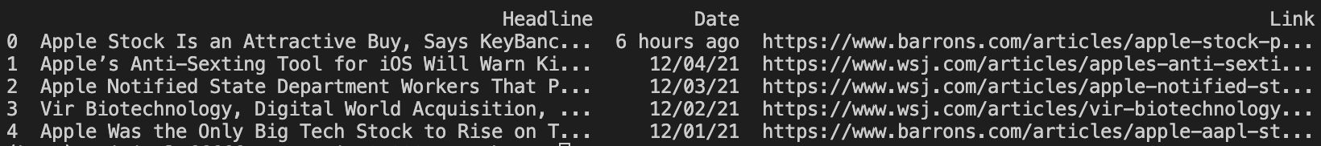
News
The headlining news section reports the top five significant news headlines for the given stock, along with dates and links collected from the trusted Wall Street Journal.
This section is meant to provide users an overview of the conversations around the company in the market and means to dive deeper.
Sample output

Slide 16
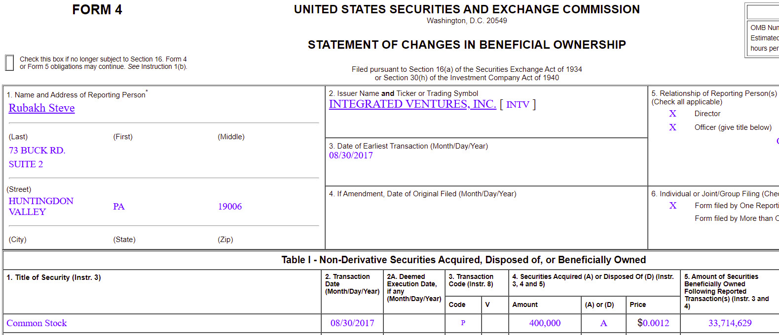
Inside Trading Activity
When insiders buy or sell shares in a company that they have information defined as privilege, they must file a form with the Securities and Exchange Commission

Slide 17
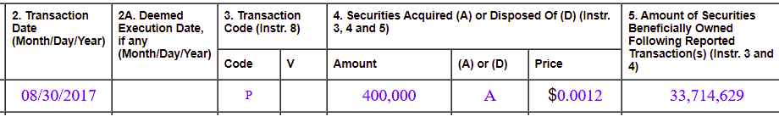
Inside Trading Activity
What kind of return on investments do insiders get? Should you buy when they buy?

Slide 18
Inside Trading Activity
Scanned millions of SEC filings over the last 10 years
Identified a random sample of 24,000 filings with insider purchases
Calculated the return on investment in subsequent one, two, and three year period:

Slide 19
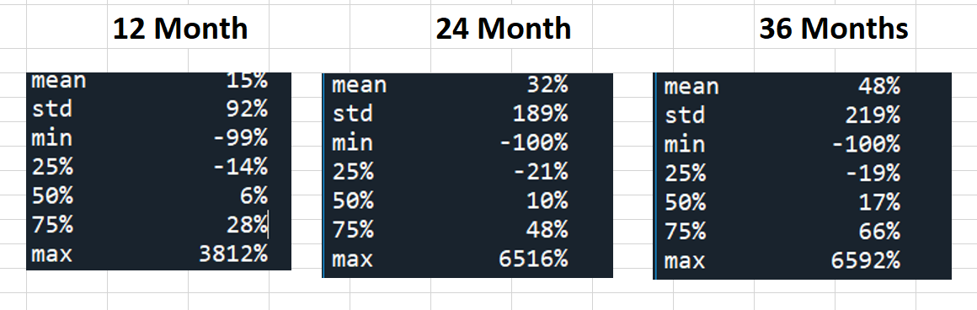
Inside Trading Activity

Slide 20
Paid Services - Trading idea # 1
Develop a model that can use the technical indicator (EMA10) of any given day (dependent on pricing from the previous 9 days) and accurately predict that day's closing price.
If our model predicts a higher closing value than the opening value, we make a trade for a single share on that day—buying at market open and selling just before market close.

Slide 21
Trading idea # 1 (Continued)
Why do we choose Linear Regression?
- Robust
- Easy to be implemented (scikit-learn)
Limitations/Assumptions?
One of these assumptions for Linear Regression is that variables in the data are independent.
For Time Series data this is often a problem since our observed values are for the same thing, recorded in sequence. This causes autocorrelation which describes how a variable is somehow related to itself (self-related.) (Chatterjee, 2012)

Slide 22
Trading idea # 1 (Continued)
Moving Averages
In stock trading, a common moving average is the Simple Moving Average (SMA). This takes the last n-many closing prices (n being the number of previous days specified) and calculates the average price of all those.
Exponential Moving Average
EMA is one of the lagging indicators that use a specific number of previous values to calculate a current value. This indicator gives more weight to recent prices than simple moving average.
As our product is to help consumers invest on the daily trade, we choose EMA_10 for our model.

Slide 23
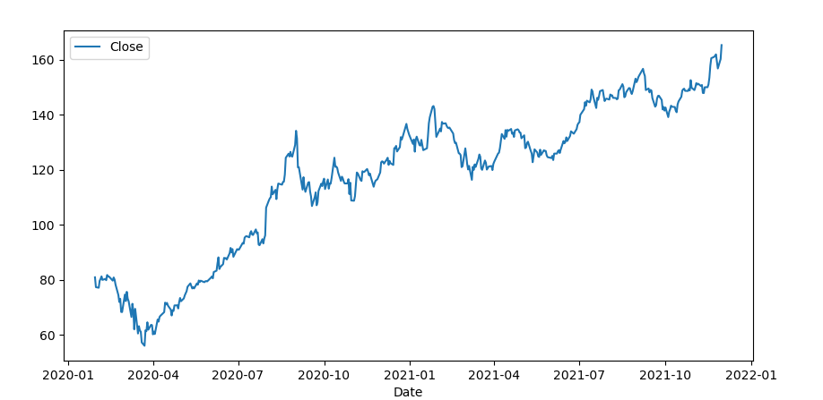
Trading idea # 1 (Continued)
Close Price Trend since January 2020

Slide 24
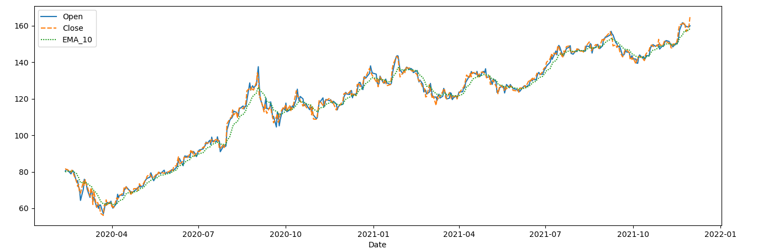
Close vs EMA_10 vs Open Price
Trading idea # 1 (Continued)

Slide 25
Train & Test the Regression Model
Trading idea # 1 (Continued)
Model Coefficients: [1.00771287]
Model Intercept -0.24635966384468588
Mean squared error (MSE) : 7.57
Mean Absolute Error: 2.1434263752701894
Coefficient of Determination (R^2): 0.99
Close= -0.246+ 1.008*EMA_10

Slide 26
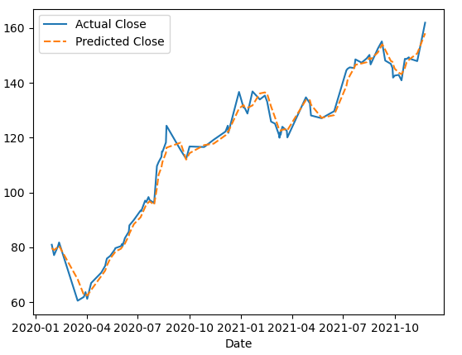
Predicted VS Actual
Trading idea # 1 (Continued)

Slide 27
Conclusion & Assumption
Trading idea # 1 (Continued)
Assumptions we make:
- We were able to purchase a share at the exact price open price recorded;
- We were able to sell that share just before closing at the exact price recorded.
Conclusion
Applying this strategy with these assumptions, our model generated $318.7. If our starting capital was $1,000, then this strategy would have resulted in a ~32% increase of total capital.
Notes:
We have 93 trading days in our test data set. And the prediction accuracy is ~71%.

